Slide 1

NATURAL LANGUAGE PROCESSING E-mails Classification
Project-72
Group-5
Members
Preeti Bodkhe
Pallavi Dhunde
Pawan Singh
Yash Khambete
Mentor- Ms. Bhanupriya

Slide 2
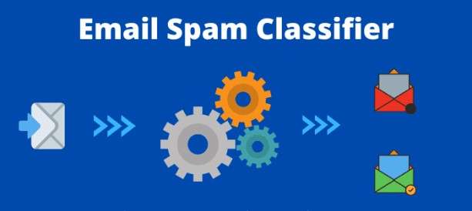
Business Objective
Inappropriate emails would demotivates and spoil the positive environment that would lead to more attrition rate and low productivity and Inappropriate emails could be on form of bullying, racism, sexual favoritism and hate in the gender or culture, in today's world so dominated by email no organization is immune to these hate emails.
The goal of the project is to identify such emails in the
given day based on the above inappropriate content
Data Set Details:
The dataset contains more than 2 lakh emails
generated by employees of an organization.
Data set details sent in csv file.
Acceptance Criterion:
Need to deploy the end results using R or Python.

Slide 3

Project Architecture/ Project Flow

Slide 4
Project Architecture/ Project Flow
Research on the project Business objective (trying to understand the importance of detecting the abusive emails)
Exploring & Cleaning the data, Text pre-processing, Performing EDA - Expanding Contractions, Tokenization, Lemmatization, Removing stop words etc.
Selection of the model based on the analysis done on different algorithms.
Building the model
Creating Training & Testing data
Train the model
Model Deployment

Slide 5
INTRODUCTION

Slide 6
Why it is important to detect the abusive emails?
These email accounts belong to people who have a habit of marking emails as spam. In email marketing, they're known as “complainers.” According to a study by MailChimp, which analyzed hundreds of millions of email campaigns, companies that have between 26 and 50 employees have the lowest abuse rates: 0.007 percent.
Some 53 percent of the world’s email traffic is spam. In 2019, people like you and I are getting about 126 emails a day. It seems, then, like a large part of our lives has moved into our (increasingly crowded) inboxes. On top of that, over 53 percent of the world’s email traffic overall is spam, according to the most recent numbers from Statista. When you consider this statistic, it’s no surprise we’ve become so sensitive about and protective of our space and time. Internet service providers (IPSs), too, have given us tools to fight back and regain control over our mailboxes. The “Unsubscribe” button allows us to fire an annoying sender for good. And the “Mark as Spam” button is a quick way to let ISPs know that a message is unsolicited and irritating
How abuse emails affect your sender reputation:
All these tools are necessary, of course. But when you're running a business, they can become harmful weapons turned against you. They can easily tarnish your reputation, and that should give you pause: As an email sender, you should consider this as a serious influence on your deliverability ability. Related: Deliver content straight to the Inbox; How to Surpass the Spam FilterISPs keep an eye on your sender reputation to determine how to handle your emails. A high complaint rate -- just as a high bounce rate -- raises a red flag. It tells inbox providers you’re not following email marketing best practices. As a result, they’ll withdraw their support, causing your emails to:
either land in the spam folder or
never even reach your subscribers
But what if you’re a legitimate business owner and you’ve never meant any harm? As Stephanie Colleton of Return Path explains, human behavior is often hard to predict, so you’re still exposed to risk. Some of your emails may come across as spam, so people won’t hesitate to hit the dreaded button.
It’s impossible to guess who those people are just by taking a long look at your email list. An email validation system, on the other hand, scans your contacts and detects abuse emails in a matter of seconds.

Slide 7
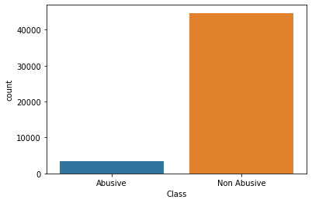
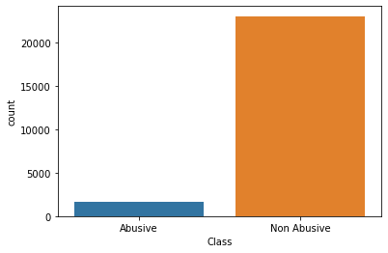
Data distribution in each class
Before dropping the duplicate emails
After dropping the duplicate emails

Slide 8
EXPLORATORY DATA ANALYSIS (EDA)

Slide 9
Text Pre-processing
Cleaning Data
Dropping unnecessary columns in a Data Frame.
Deleting the duplicate values
Removing special characters and numbers from the data
Using . str() methods to clean columns.
Removing unwanted words
Renaming columns to a more recognizable set of labels.
Skipping unnecessary rows in a CSV file.
Exploratory Data Analysis (EDA)
Remove special characters using library re
Spell Check using library autocorrect
Expanding Contractions using library contractions
Removing Punctuations
Tokenization using library nltk
Converting Uppercase letters to Lowercase
Removing Stopwords using library nltk
Stemming
Lemmatization
WordCloud

Slide 10
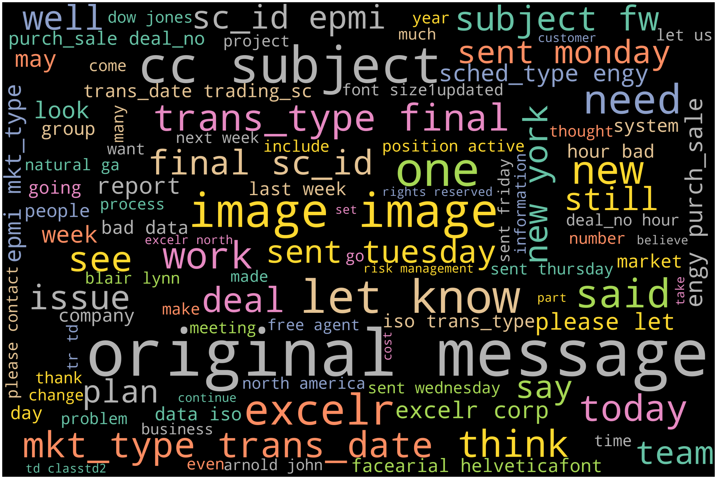
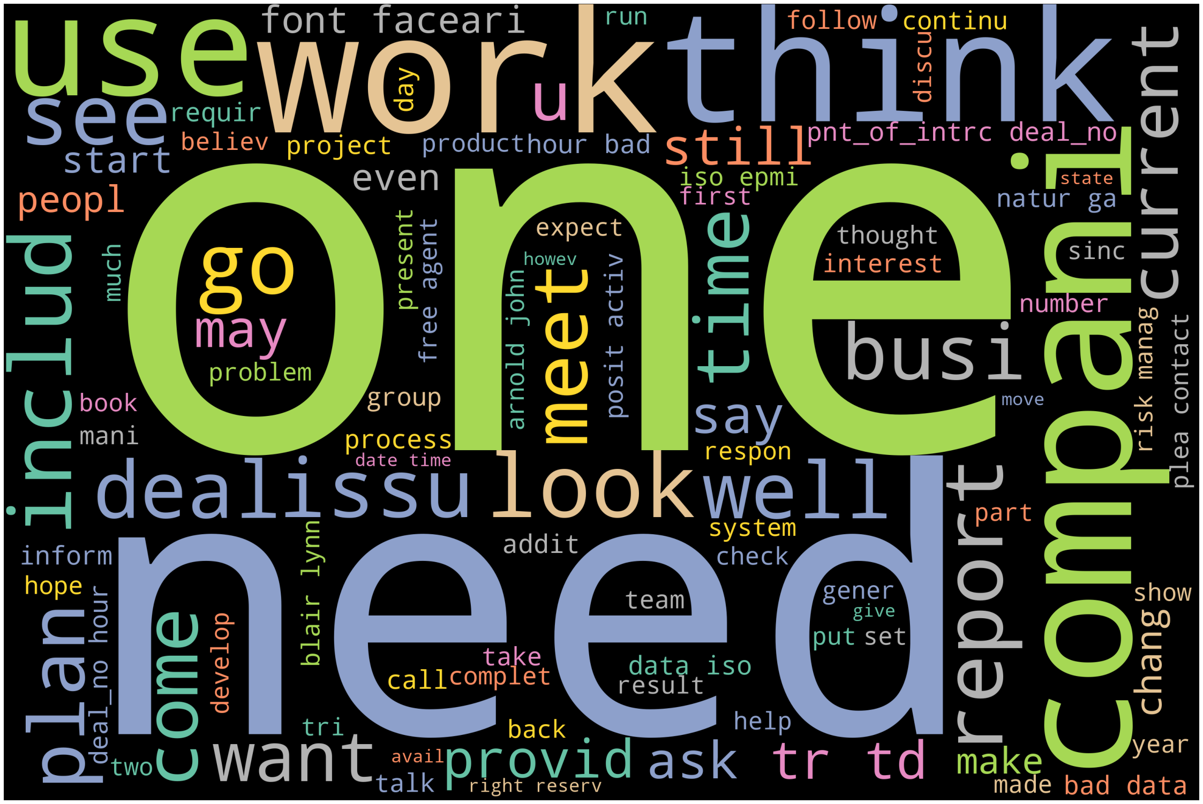
WordCloud
There are some words which are not much useful for our classification problem.
So , we have removed those words from our dataset for getting better classification .
These the word clouds of before and after removal of such words.
Before cleaning the data
After cleaning the data

Slide 11
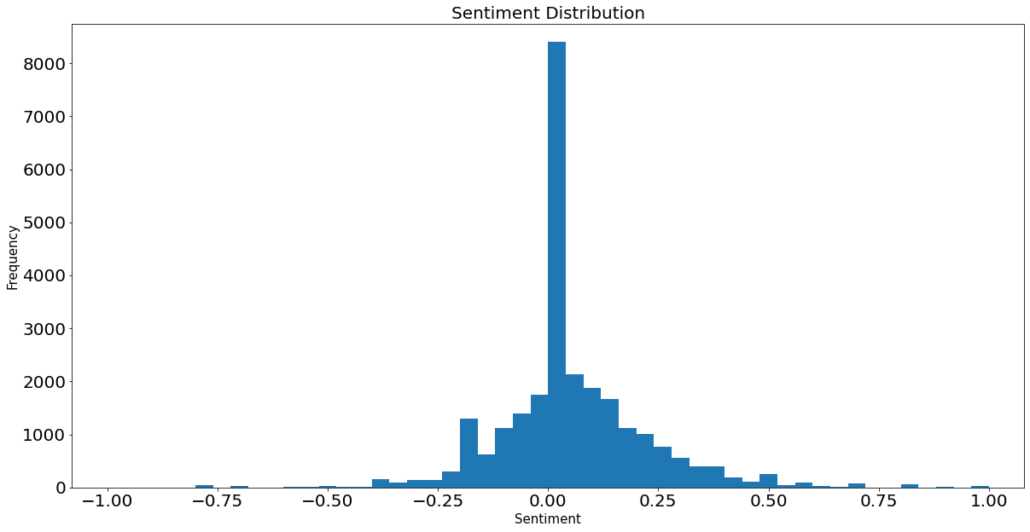
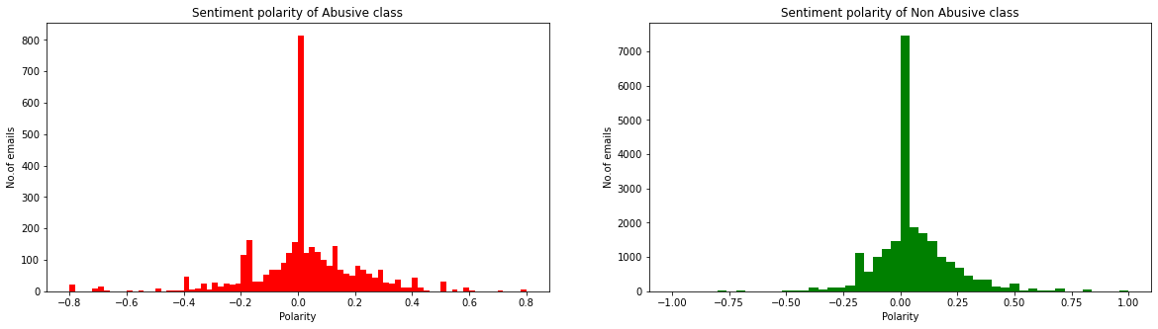
Sentiment polarity range
The histogram to our right side is skewed to towards positive polarity as we know there are more Non abusive mails than abusive mails in our data.

Slide 12
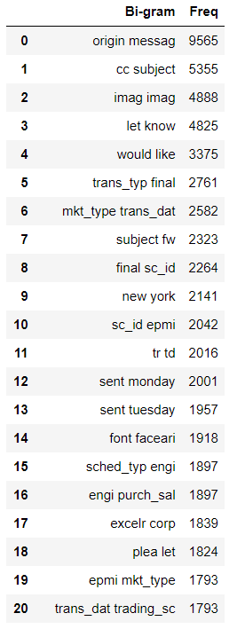
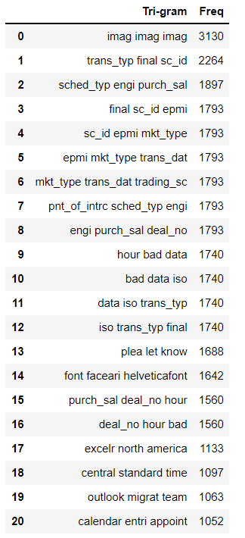
N-gram
These are top 20
Bi-gram and
Tri-gram word used in the emails dataset.

Slide 13
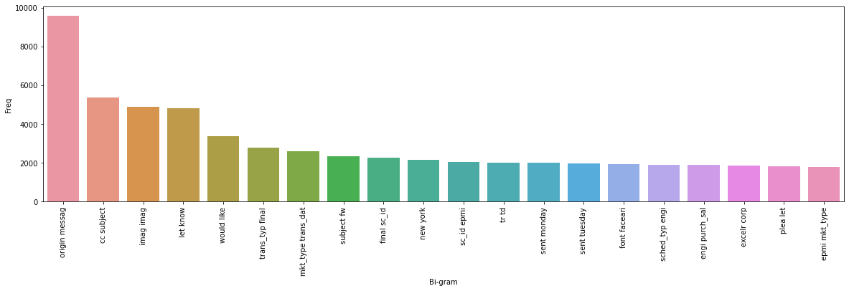
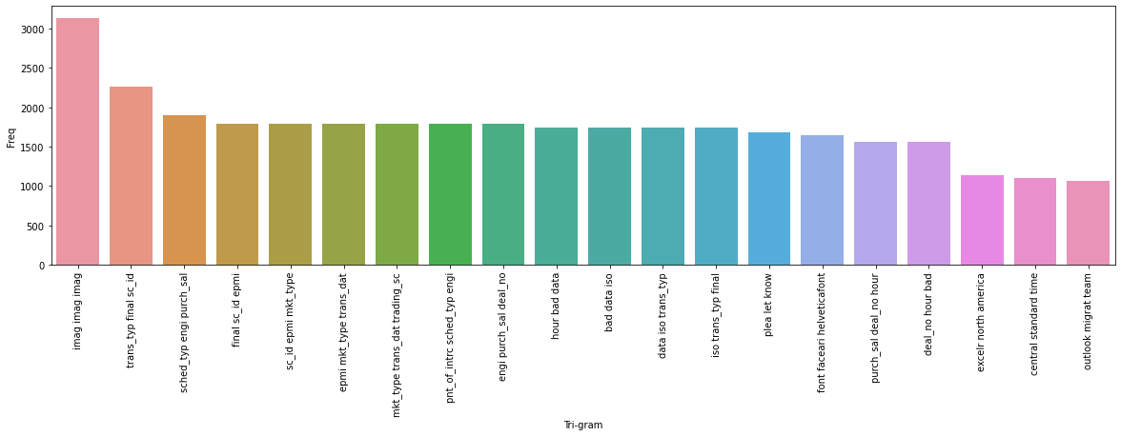
These are top 20 Bi-gram and Tri-gram word used in emails

Slide 14
FEATURE EXTRACTION

Slide 15
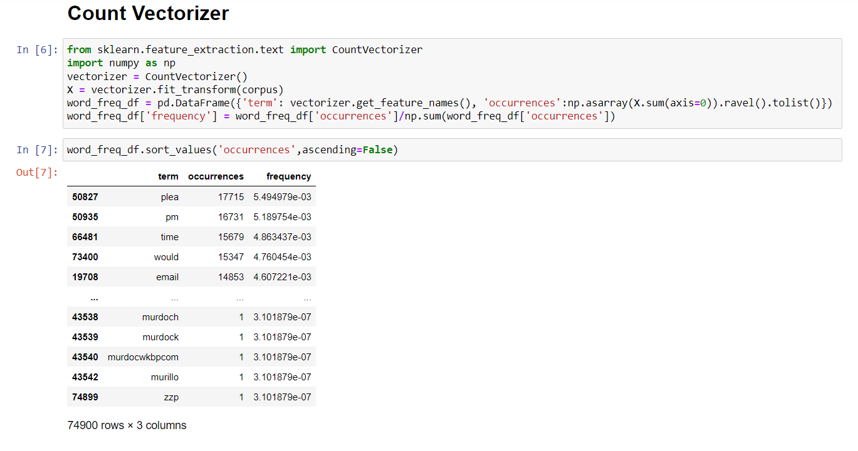

Slide 16
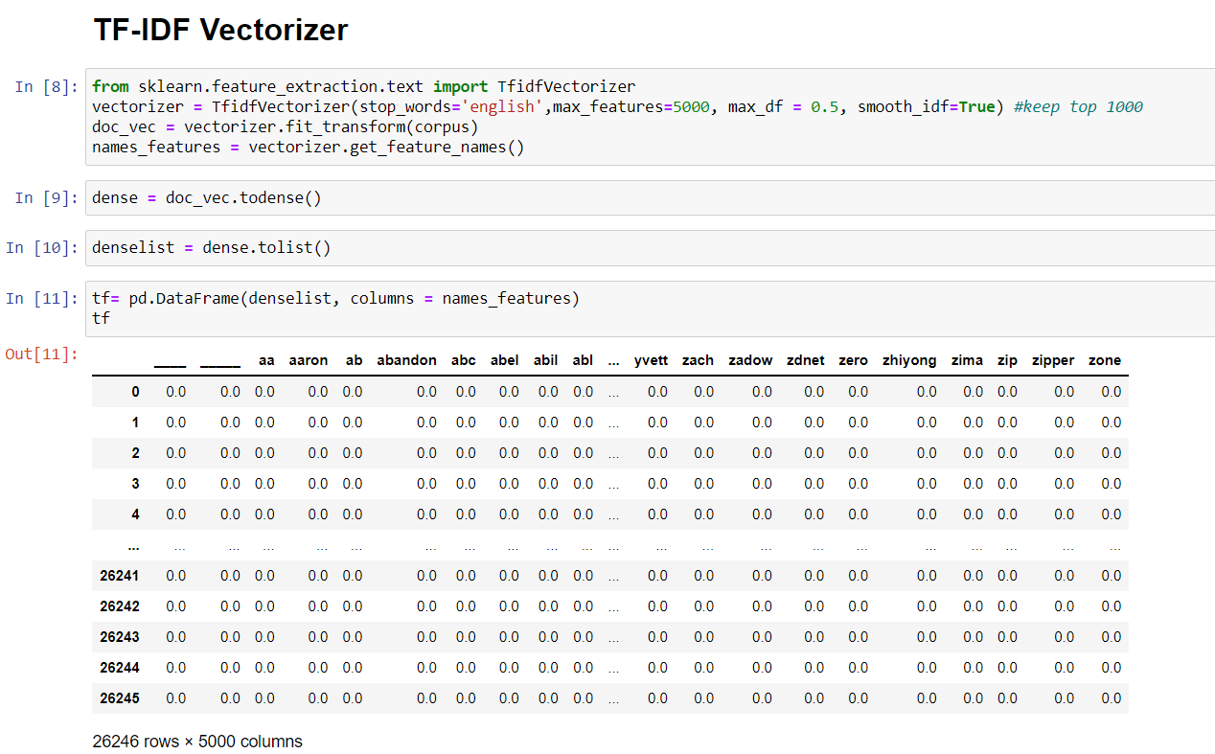

Slide 17
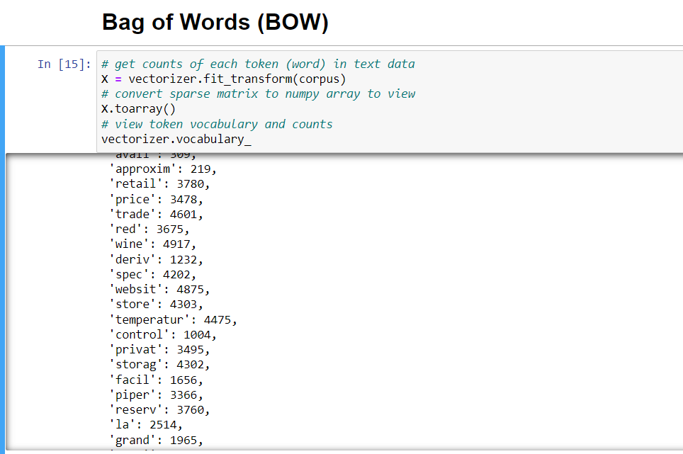

Slide 18
MODEL BUILDING

Slide 19
After performing EDA and Feature Extraction on our dataset we have stared model building.
Model Validation technique : We have divided the data into Train and Test with 33% as Test
We used SMOTE method for balancing the minority class in our dataset.
The models we have build are
Logistic Regression Model (Basic classification model)
Recurrent Neural Network (RNN) Model
Support vector Machine (SVM) Model
Random Forest classification
Multinomial Naive Bayes

Slide 20
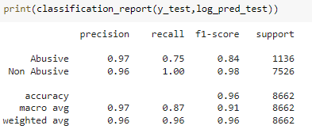
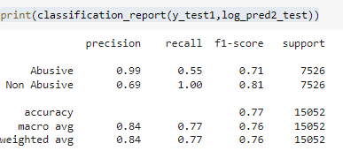
Logistic Regression Model It is a classification algorithm. It is used to predict a binary outcome (1 / 0, Yes / No, True / False) given a set of independent variables. In simple words, it predicts the probability of occurrence of an event by fitting data to a logit function, multi_class='multinomial'
Logistic Regression Using Default data
Accuracy of Training data = 97.20200181983621
Accuracy of Test data = 96.36342646040175
Logistic Regression Using Balanced data
Accuracy of Training data = 81.68843892880471 Accuracy of Test data = 77.32527238905129

Slide 21
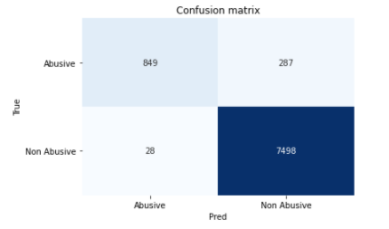
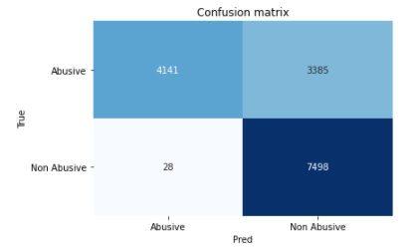
These are the Confusion Matrix
Logistic Regression Using Default data
Logistic Regression Using Balanced data

Slide 22
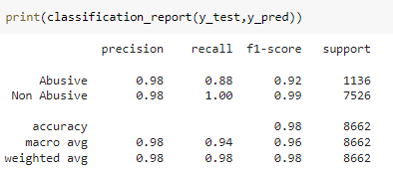
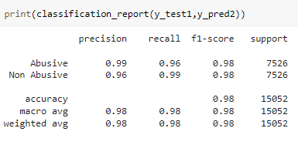
SVM Model (Support Vector Machine) A support vector machine (SVM) is machine learning algorithm that analyzes data for classification and regression analysis
SVM with default data using TF-IDF
Accuracy of Training data =99.55072793448589
Accuracy of Test data = 98.08358346802125
SVM with balanced data using TF-IDF
Accuracy of Train data = 99.7615937295885
Accuracy of Test data = 97.63486579856497

Slide 23
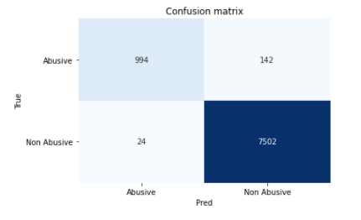
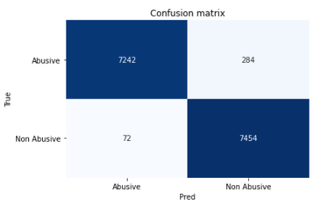
These are the Confusion Matrix
SVM with default data using TF-IDF
SVM with balanced data using TF-IDF

Slide 24
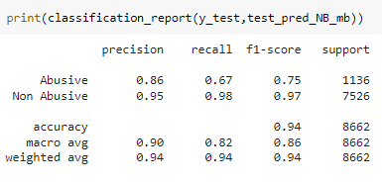
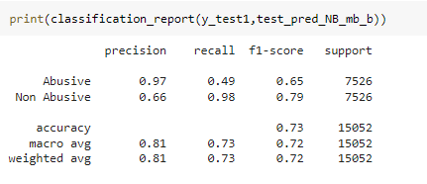
Naive Bayes Model A naive Bayes classifier is an algorithm that uses Bayes' theorem to classify objects. Naive Bayes classifiers assume strong, or naive, independence between attributes of data points. Popular uses of naive Bayes classifiers include spam filters, text analysis and medical diagnosis.
Multinomial Navie Bayes model with default data
Accuracy of Training data=94.91583257506825
Accuracy of Test data=94.1353036250288
Multinomial Navie Bayes model with balanced data
Accuracy of Training data =92.73677335075115
Accuracy of test data= 73.438745681637

Slide 25
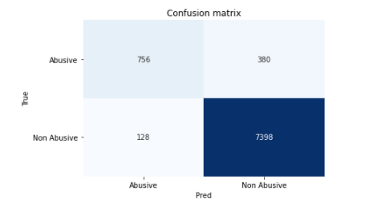
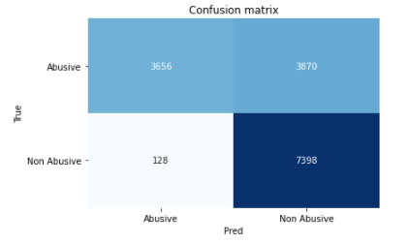
These are the Confusion Matrix
Multinomial Navie Bayes model with default data
Multinomial Navie Bayes model with balanced data

Slide 26
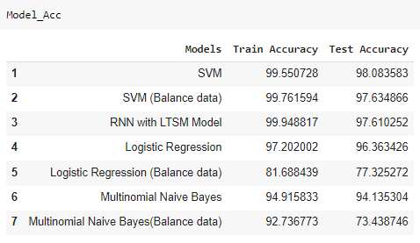
Model Summary

Slide 27
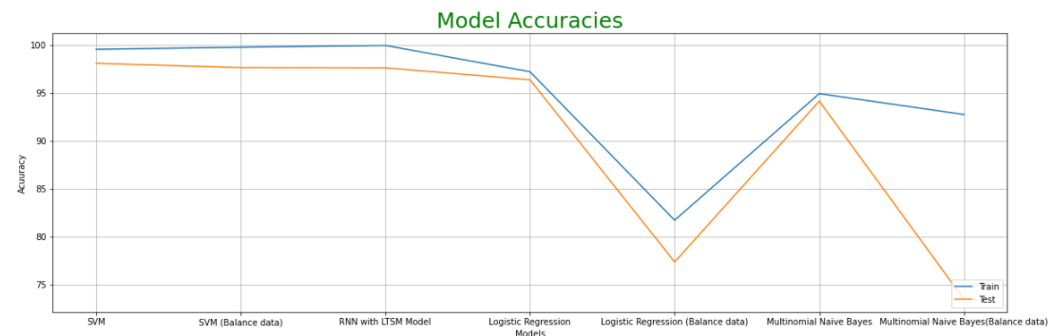
Model Accuracy

Slide 28
DEPLOYMENT USING STREAMLIT

Slide 29
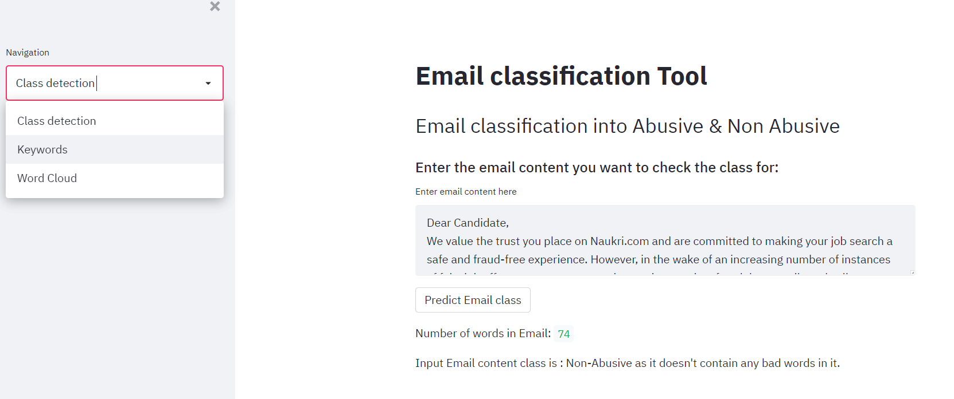
Non-Abusive Class detection

Slide 30
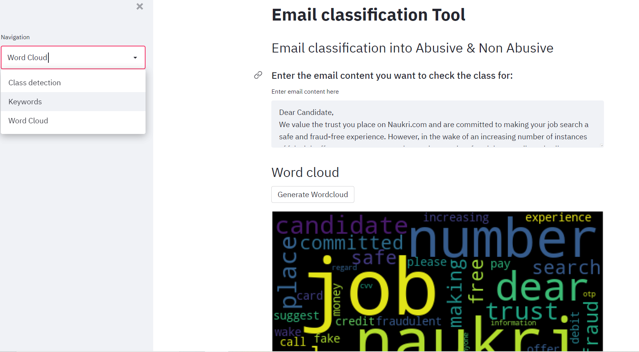
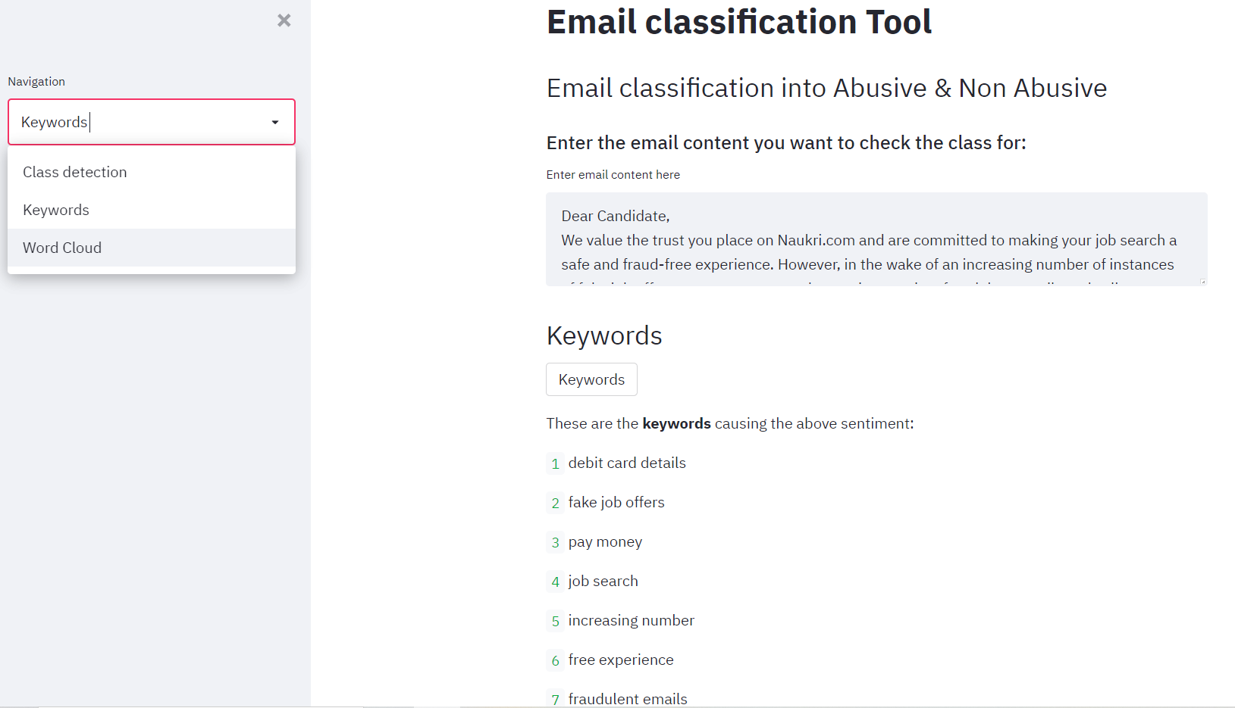
Non-Abusive Class : Word Cloud
Non-Abusive Class : Keywords

Slide 31
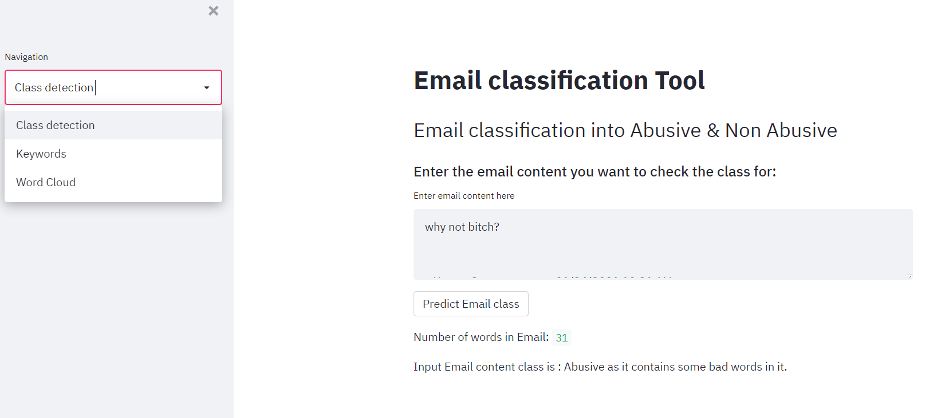
Abusive Class detection

Slide 32
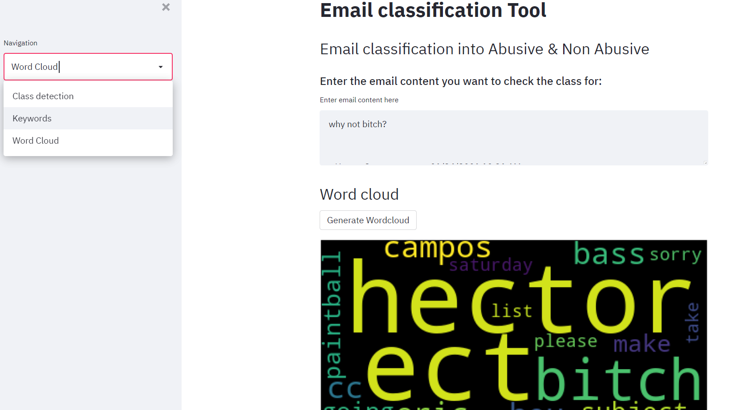
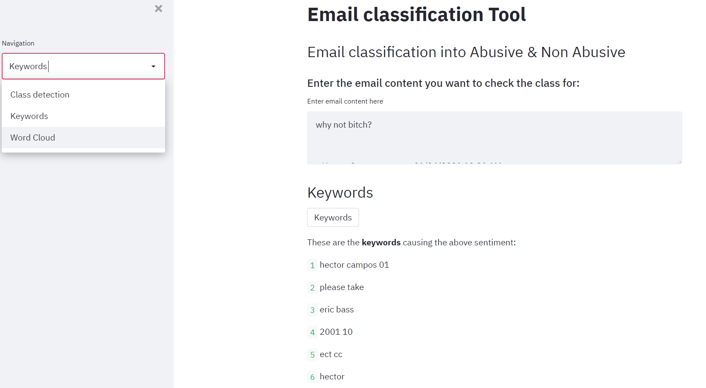
Abusive Class : Word Cloud
Abusive Class : Keywords

Slide 33
CHALLENGES FACED

Slide 34
CHALLENGES FACED
OVERCOMING CHALLENGES
Dealing with large dataset
Imbalanced data
It took huge amount of time to build the model
Coding the .py file according to model we have chosen to deploy.
Deleted the duplicate values from the data
We have used SMOTE method for balancing the data as it creates synthetic data of minority class.
We had to give the certain time to build the model properly.
Study the model properly in terms to write the accurate code for .py file.

Slide 35


